Slide 1

INTERNET OF THINGS
UNAUTHORISED
PARKING
ALERT
PRESENTED BY:
TEAM TRINETRA

Slide 2
TEAM MEMBERS
18R21A0593-K.Swarna
18R21A05P3-T.Naveen
18R21A05K8-E.Manohar

Slide 3
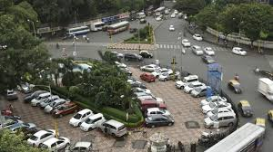
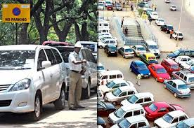
Problem Statement-
Though we have a lot of rules regarding parking system people still park in NO PARKING slots which leads to various traffic issues

Slide 4

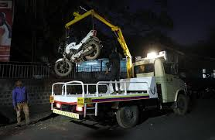
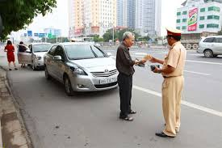
EXISTING SOLUTION
No parking boards are placed at no parking slots.
Towing vans are used to move the vehicle from illegal parking slots.
Fines are been collected.

Slide 5
Proposed Solution:
UNAUTHORISED PARKING ALERT:
A large number of personnel are deployed to check for unauthorized parking and fine those owners. But owners evade the fine by various illegal means. Towing vans need to manually search for the illegally parked vehicles. This system requires large over head costs in man power , payment, fuel and other physical surveillance. Here we propose a project that allows for automatic illegal parking detection and alerting . Here we use the ultrasonic sensors which senses the vehicles and a buzzer and camera is inserted at the no parking slot which gives an alert ring to the person for his illegal parking ,if the alert message is neglected by the person then the number plate of the respective vehicle is send to the near by police station .

Slide 6
TECHNOLOGY ARCHITECTURE:
ULTRASONIC SENSOR
BUZZER
GSM MODULE
POLICE STATION
RASPBERRY PI

Slide 7
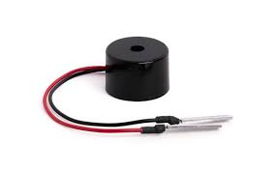
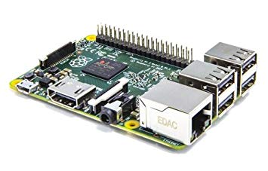
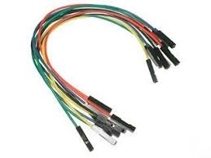
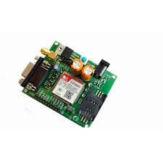
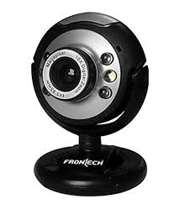
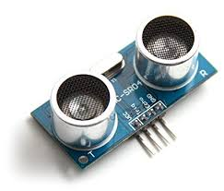
Components Required:
BUZZER
CABLES
RASPBERRY PI 3
ULTRA
SONIC
SENSOR
GSM MODULE-900
WEB
CAM

Slide 8
SOFTWARE USED:
MC Programming Language:Embeded C
Arduino UNO

Slide 9
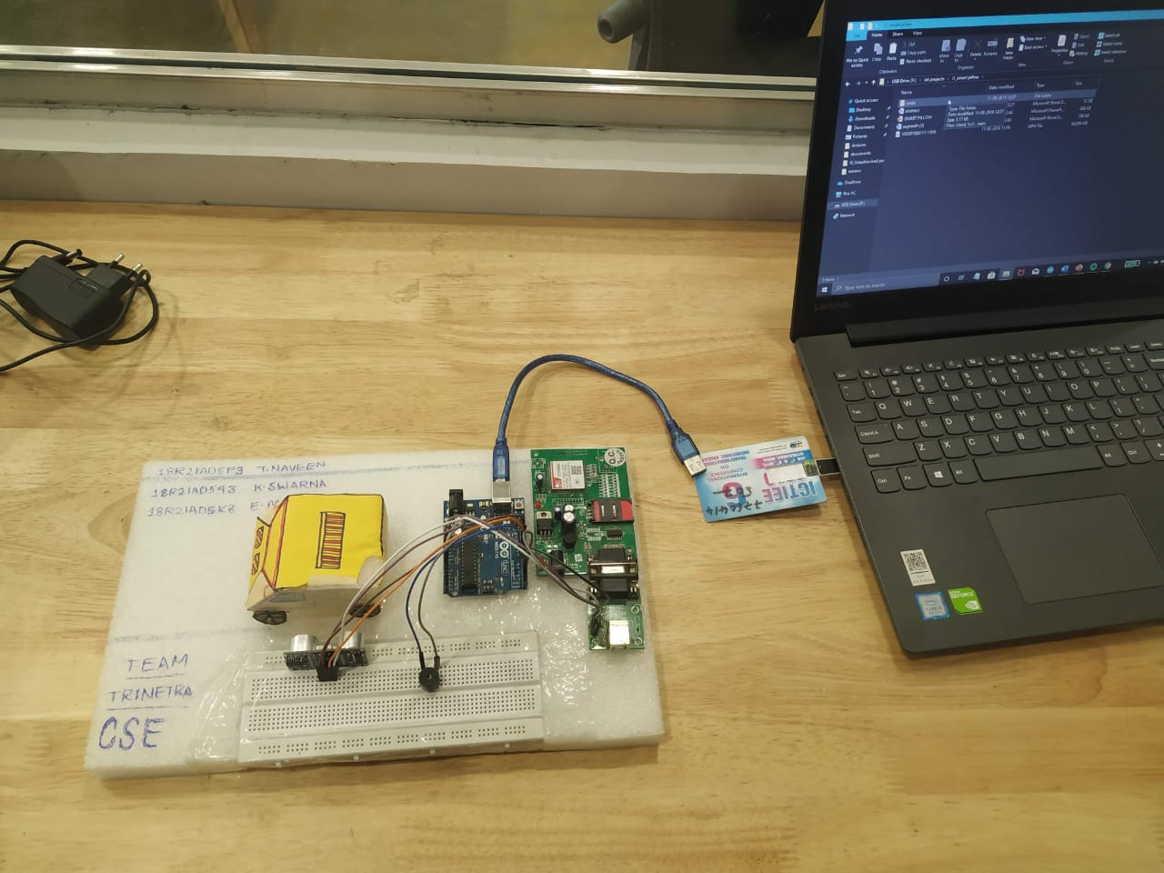
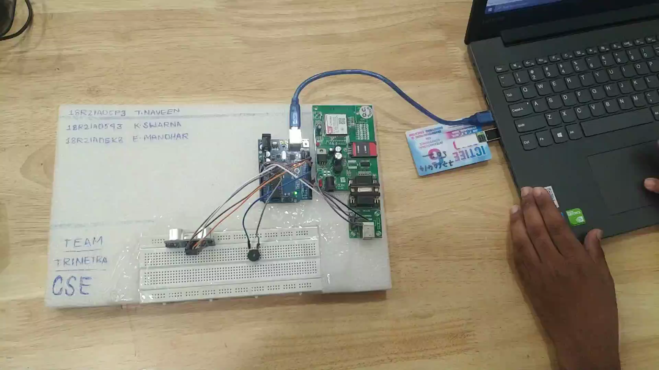
STATUS OF THE PROJECT:

Slide 10
THANK YOU

